Slide 1

high Cloud airlines
Data Analyst Project
Excel
Power-BI
Tableau
MySQL
Group – 4
Khandesh Sri Narasimha
Shweta Shridhar Mishra
Honey kedia Shweta
Shrikant Balsu Rathod
Bijal Manish Rana

Slide 2
Introduction
Introduction to High Cloud Airlines ✈️
High Cloud Airlines is a leading airline committed to efficiency, passenger satisfaction, and operational excellence. With a strong network of domestic and international routes, the airline focuses on maximizing load factor, optimizing route efficiency, and enhancing overall customer experience.
Key strengths of High Cloud Airlines include: 1.Extensive Route Network – Connecting major business and leisure destinations. 2.Efficient Fleet Management – Ensuring optimal aircraft utilization. 3.Customer-Centric Approach – Focused on service quality and affordability. 4.Data-Driven Decision Making – Leveraging analytics for performance improvement.
Through continuous innovation, strategic partnerships, and data-driven insights, High Cloud Airlines aims to enhance operational efficiency, increase profitability, and provide a seamless travel experience for its passengers.

Slide 3
objective
To gain a comprehensive understanding of "High Cloud Airlines" operations through data analysis . This will involve investigating load factors, identifying top carrier names based on passenger preference, analyzing popular routes, and exploring other key metrics. The ultimate goal is to provide actionable recommendations that can enhance operational efficiency and profitability.

Slide 4
Project scope
The Project aimed to leverage the power of data analysis and extract valuable insights to optimize high cloud airline operations and performance. The specific scope of the project focused on analyzing key performance indicators (KPIs) to gain deeper understanding of:• Load Factor• Passenger Preferences• Popular Routes• Operational Efficiency

Slide 5
Dataset Overview
Datasets
Main dataset ( Rows : 1,10,850) - Large dataset
Aircraft Groups ( Rows : 11)
Aircraft Type ( Rows : 380)
Airlines ( Rows : 21,578)
Carrier Groups ( Rows : 9)
Carrier Operating Region ( Rows : 7)
Destination Markets ( Rows : 1,904)
Distance Groups ( Rows : 26)
Flight Types ( Rows : 5)
Origin Markets ( Rows : 1,842)

Slide 6
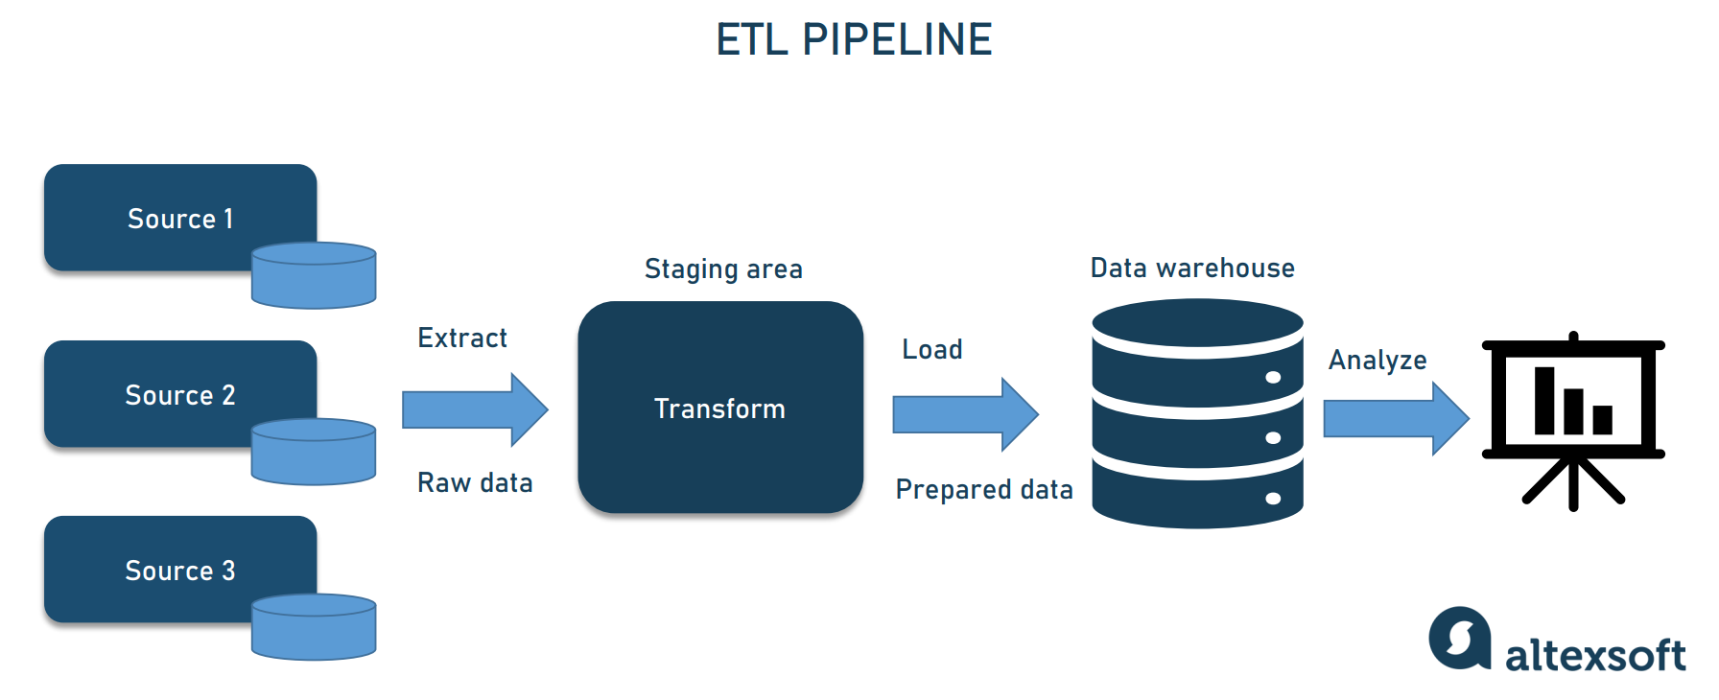
Data analyst cycle (ETL Process)

Slide 7
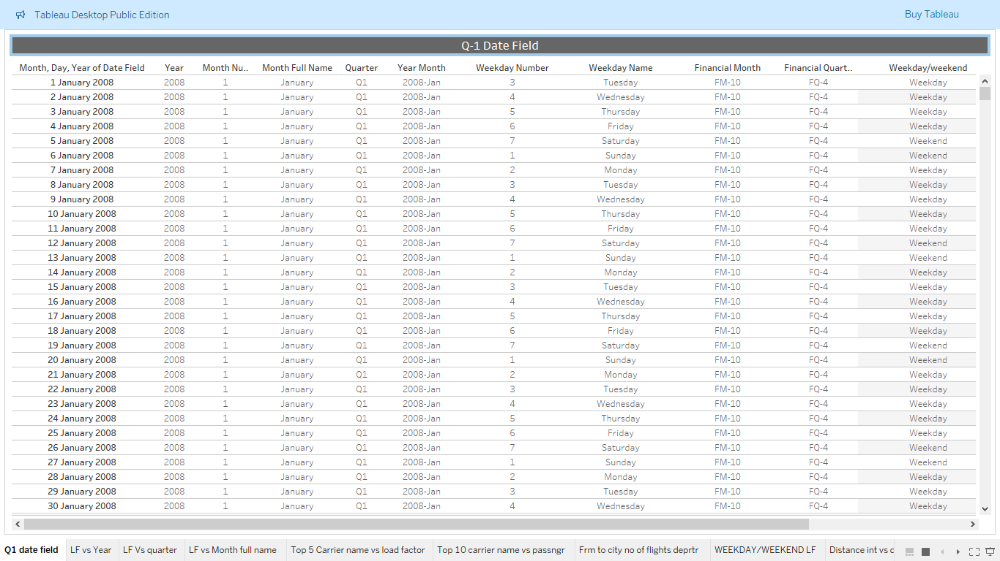
Q-1 DATE Field (Tableau)

Slide 8

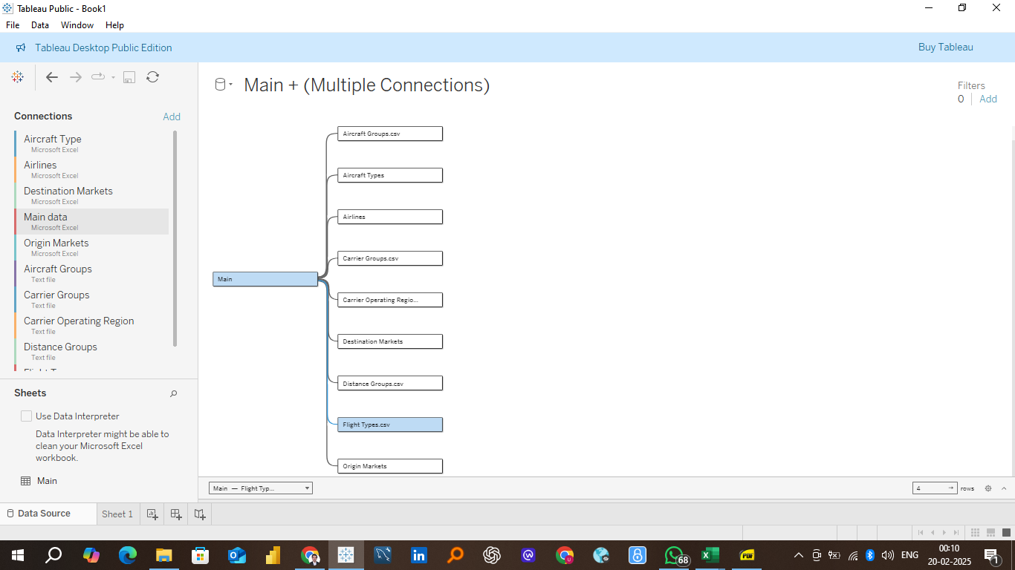
Tableau Data Modelling

Slide 9
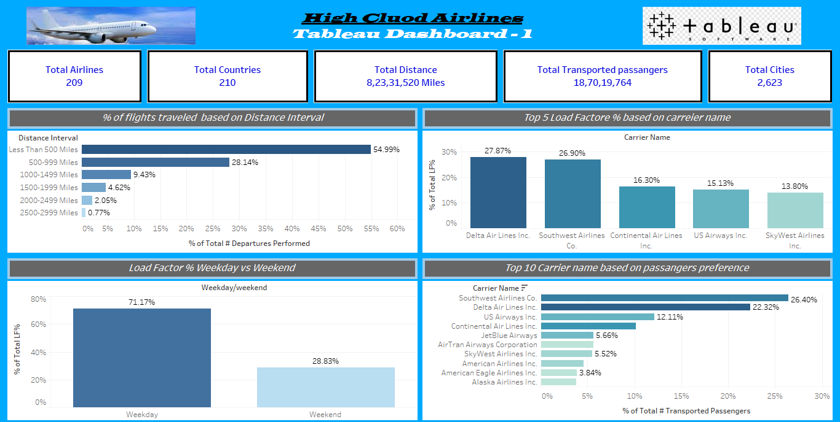
Tableau Dashboard - 1

Slide 10
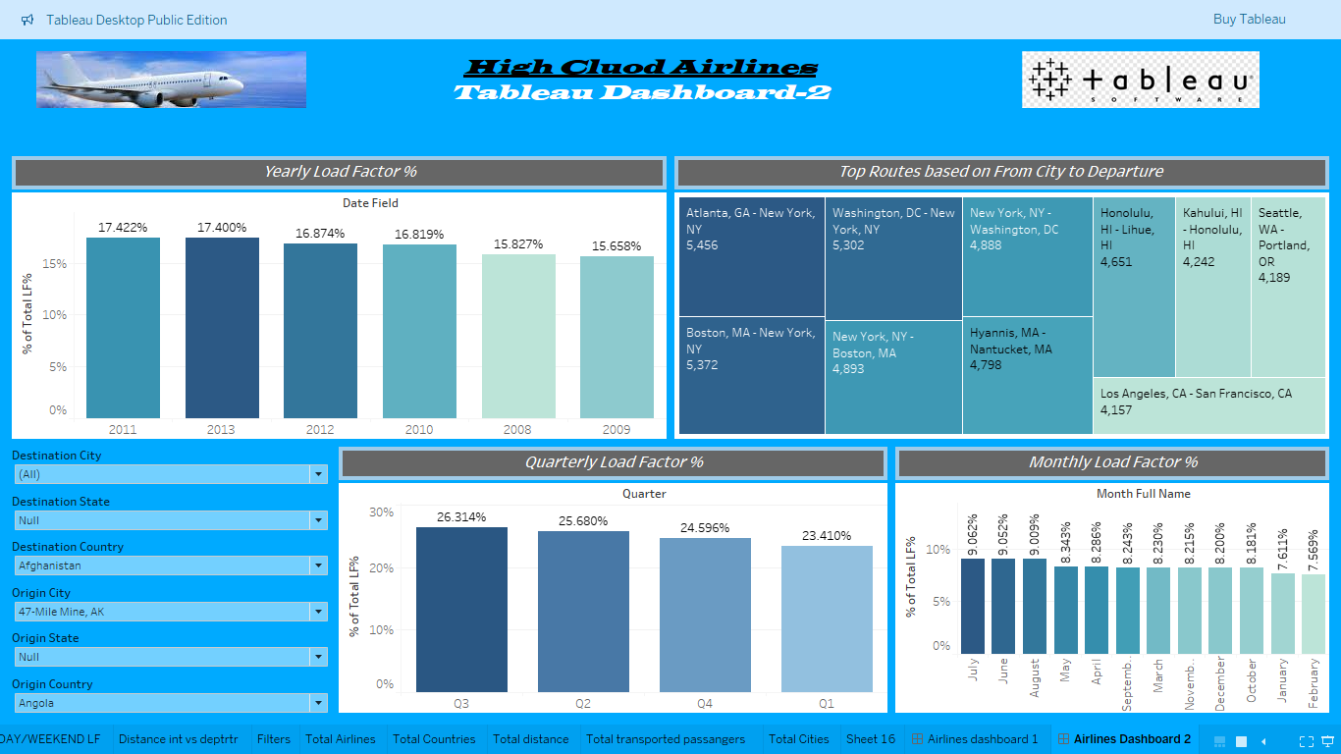
Tableau Dashboard - 2

Slide 11

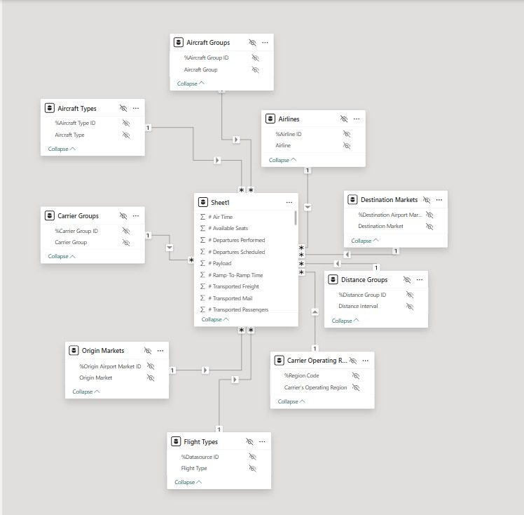
Power-BI DATA MODELLING

Slide 12
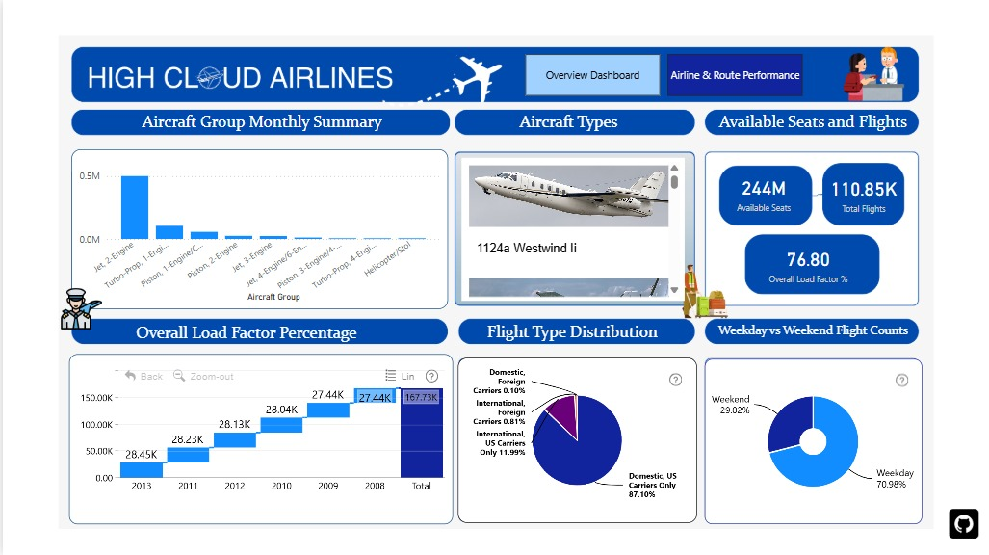
Power-BI Dashboard-1

Slide 13
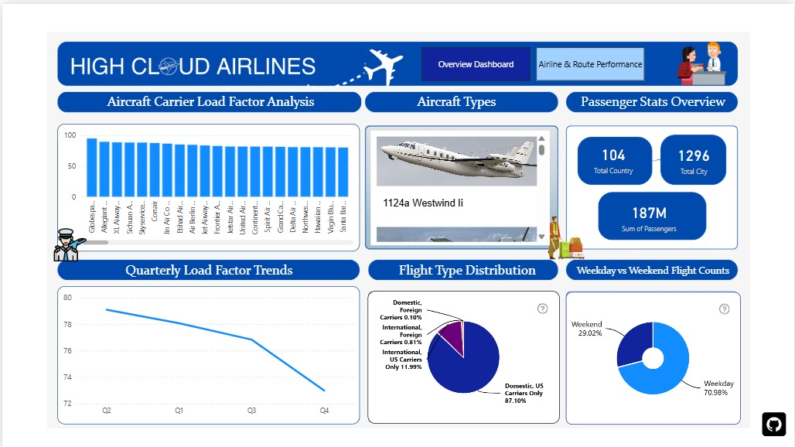
Power-BI Dashboard-2

Slide 14

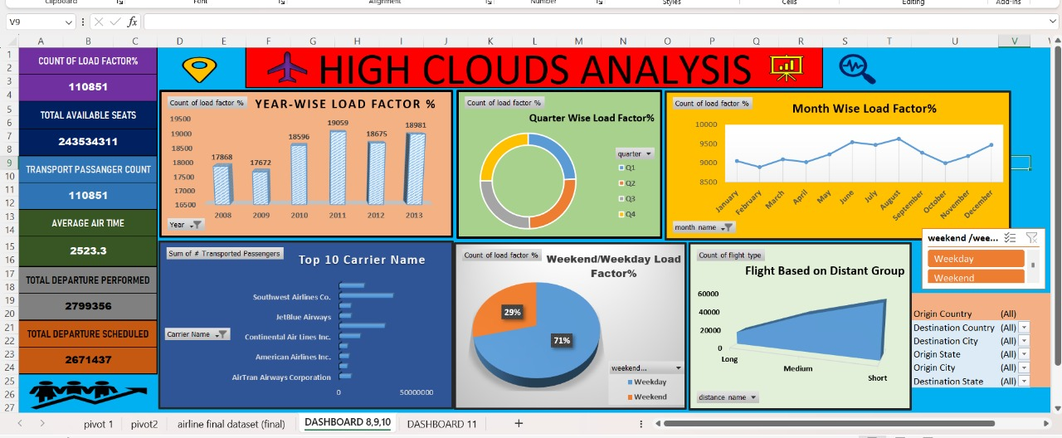
Excel Dashboard-1

Slide 15
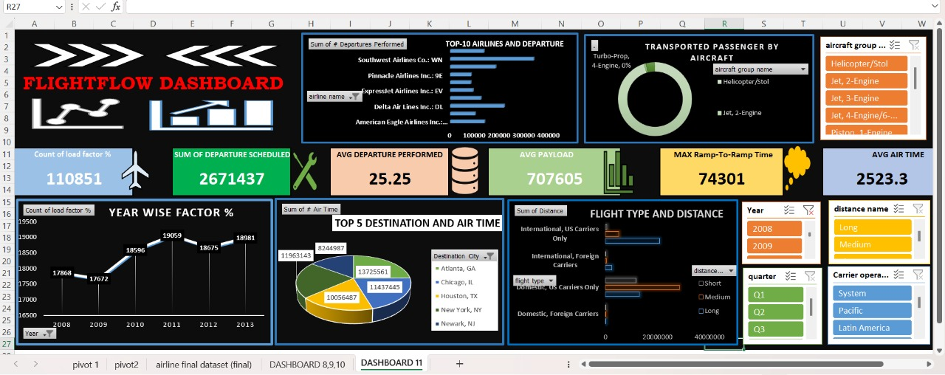
Excel Dashboard-2

Slide 16
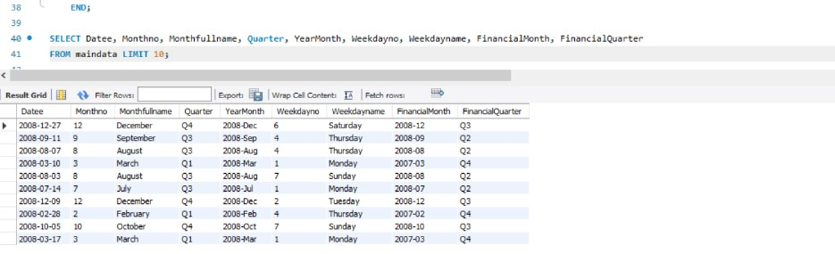
MYSQL

Slide 17
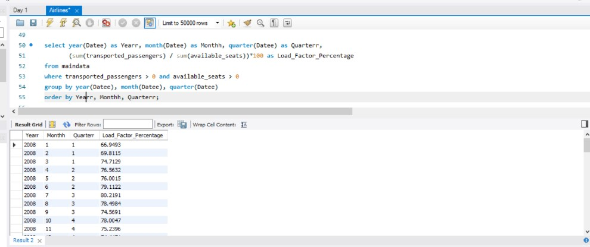
MYSQL

Slide 18
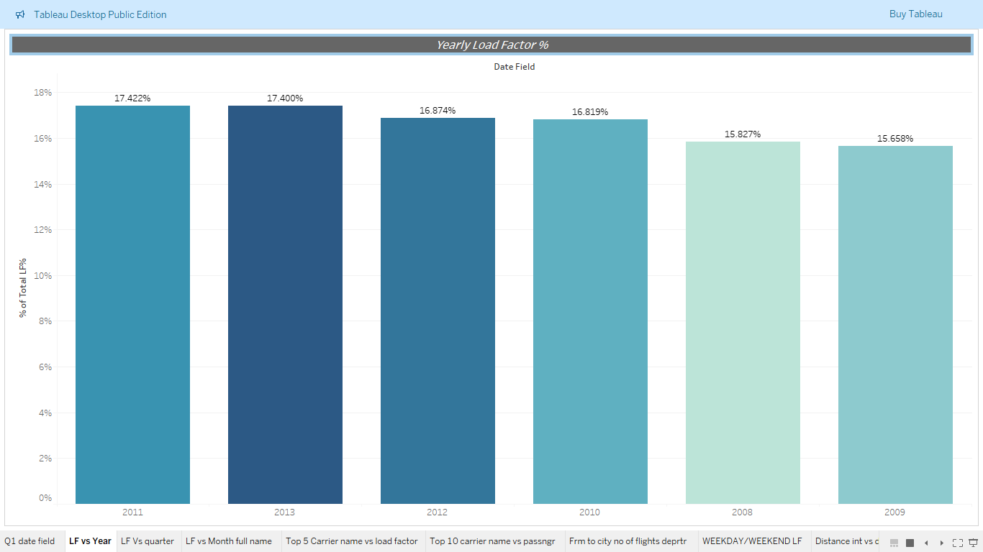
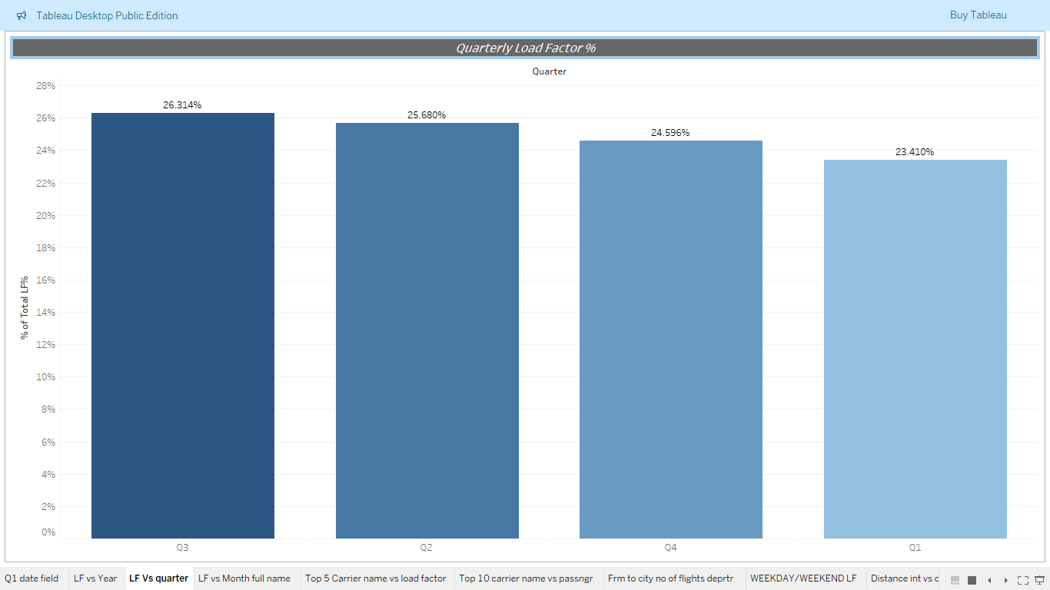
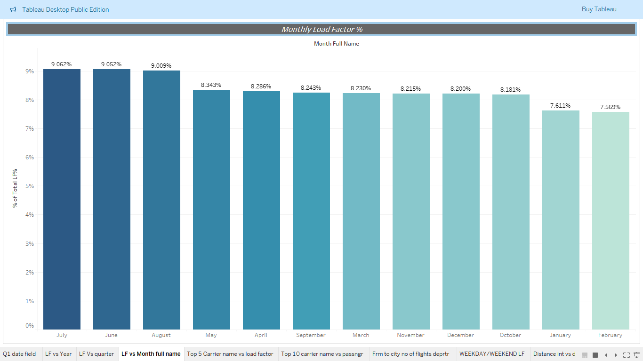
1. the load Factor percentage on a yearly , Quarterly , Monthly basis
KPI
Insights and Business Recommendation :
1. Load Factor is declining yearly, with the highest at 17.5% (2011) and the lowest at 15.7% (2009), indicating inefficiencies in seat utilization.
2.Q3 (26.31%) and summer months (June-August) have the highest Load Factor, while Q1 (23.41%) and January-February perform the worst, showing strong seasonality effects.
3.Optimize pricing and promotions in low-demand months (Jan-Feb) and increase flight frequencies in peak months (June-Aug) to maximize revenue and seat occupancy.
4. Adjust route planning by reducing underperforming flights and expanding high-demand routes, while leveraging weekend travel trends for higher efficiency.
5. Dynamic pricing, seasonal scheduling, and targeted marketing strategies can significantly improve Load Factor, reduce operational losses, and enhance overall profitability.

Slide 19
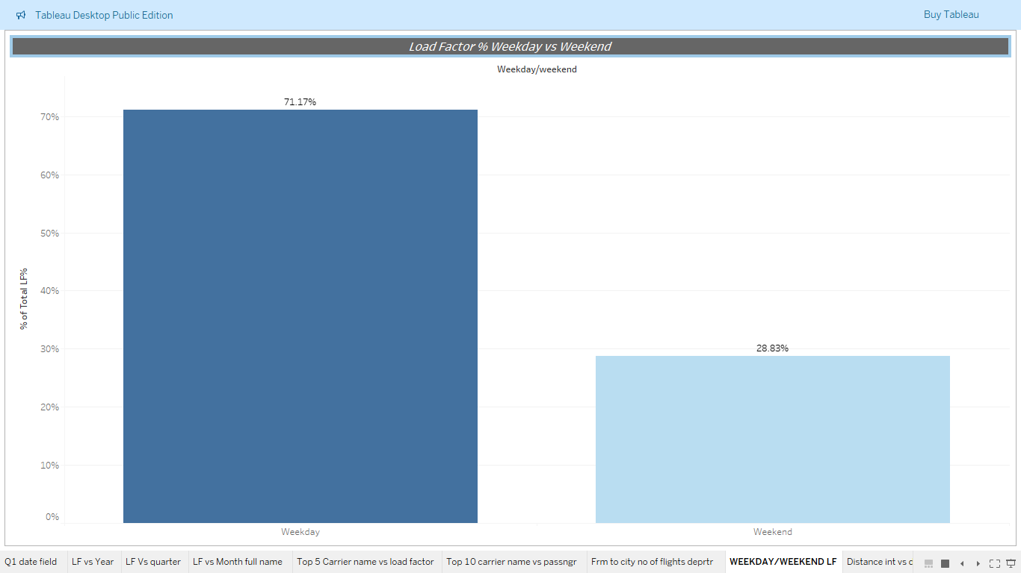
2.Load factor weekday vs weekend
KPI
Insights and Business Recommendation :
Weekdays have a significantly higher Load Factor (71.17%) compared to weekends (28.83%), indicating stronger demand for business and corporate travel.
Low weekend occupancy suggests leisure travel demand is weak, leading to inefficient seat utilization and potential revenue loss.
Introduce weekend travel discounts, family packages, and holiday promotions to attract leisure travelers and improve weekend Load Factor.
Optimize flight schedules by increasing weekday business routes and launching weekend leisure-focused destinations to balance demand.
Dynamic pricing, targeted marketing, and route adjustments can help boost weekend occupancy, maximize aircraft utilization, and drive overall revenue growth.

Slide 20
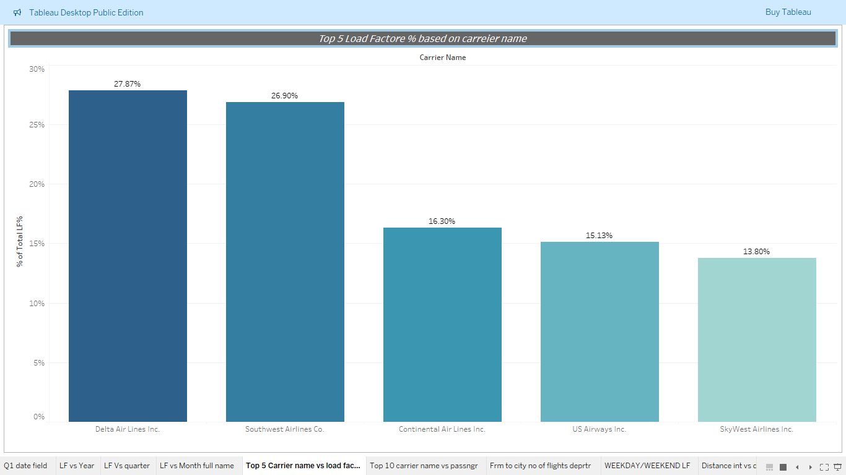
3.Top 5 load factor based on carrier name
KPI
Insights and recommendation:
Delta Airlines (27.87%) and Southwest Airlines (26.90%) have the highest Load Factor, indicating strong passenger demand and efficient capacity utilization.
Continental Airlines (16.30%), US Airways (15.13%), and SkyWest Airlines (13.80%) have significantly lower Load Factors, suggesting potential operational inefficiencies or weaker market positioning.
Low-performing airlines should analyze route demand, optimize fleet allocation, and introduce competitive pricing strategies to attract more passengers.
Top-performing airlines should capitalize on their high demand by increasing flight frequencies and expanding profitable routes to sustain growth.
Strategic partnerships, customer loyalty programs, and targeted marketing efforts can help low-performing airlines improve their Load Factor and overall competitiveness.

Slide 21
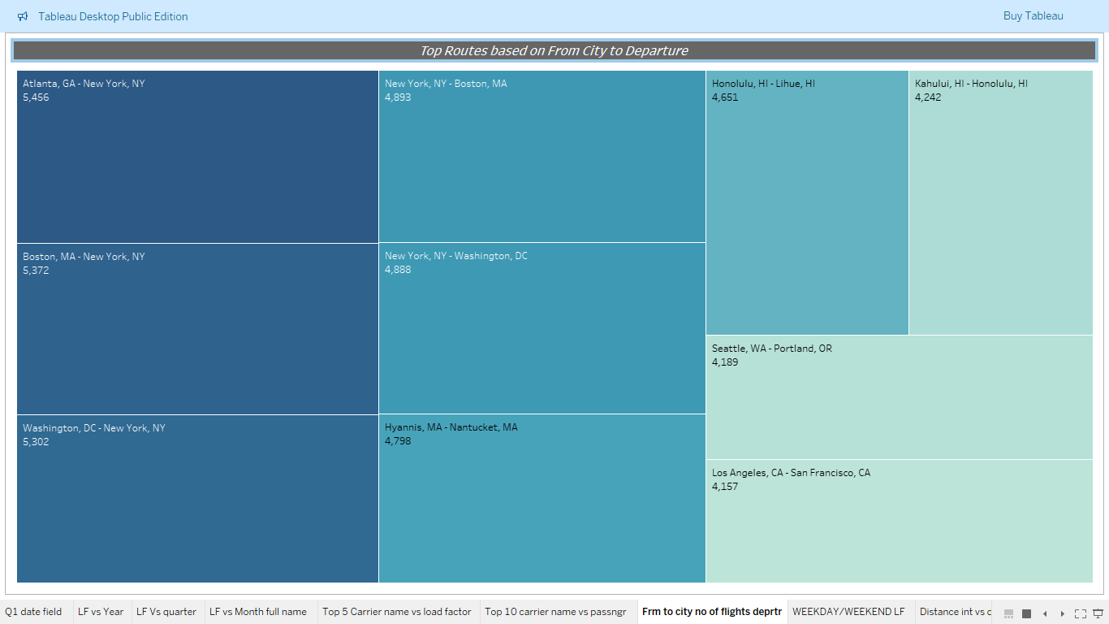
4.Top rOute based on from city to departure
KPI
Insights and Business Recommendation :
High-traffic routes are concentrated in major business hubs (New York, Boston, Washington, Atlanta) and leisure destinations (Hawaii, California).
Routes like Atlanta–New York (5,456 departures) and Boston–New York (5,372 departures) indicate strong demand for frequent business travel.
Hawaii routes (Honolulu–Lihue, Kahului–Honolulu) have high departures, showcasing significant demand for inter-island travel and tourism.
Increase flight frequencies and deploy larger aircraft on high-demand routes to optimize revenue and passenger capacity utilization.

Slide 22
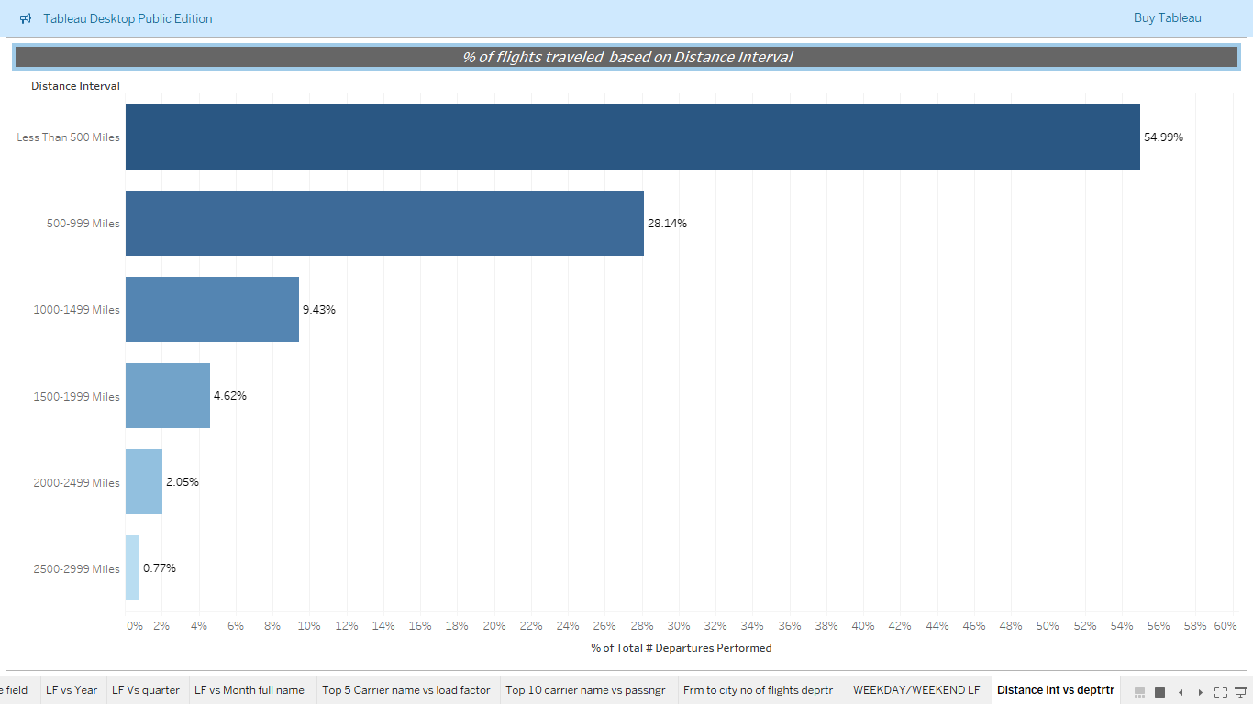
5.Percentage flights traveled based on distance interval
KPI
Insights and Business Recommendations :
Short-haul flights (less than 500 miles) account for the majority (54.99%) of total departures, indicating a strong focus on regional travel and frequent short-distance operations.
Medium-haul flights (500–1499 miles) represent 37.57% of total departures, showing stable demand but potential for further optimization in route planning and fleet usage.
Long-haul flights (1500+ miles) contribute only 7.44% of total departures, suggesting lower frequency due to either lower passenger demand or cost-related constraints.
To improve efficiency, airlines should optimize fleet allocation by using smaller aircraft for short-haul routes and increasing marketing efforts to boost demand for long-haul travel.
Enhancing connectivity through hub-and-spoke models, dynamic pricing for longer routes, and strategic alliances with international carriers can help balance route profitability and maximize overall airline efficiency.

Slide 23
Conclusion
Load Factor Optimization – Yearly Load Factor shows a decline, with the highest in 2011 (17.5%) and lowest in 2009 (15.7%), highlighting the need for better seat utilization and demand-based scheduling.
Seasonal & Weekly Trends – Q3 (26.31%) and summer months have the highest Load Factor, while weekdays (71.17%) outperform weekends (28.83%), suggesting business travel dominance and the need for leisure-focused weekend promotions.
Carrier Performance – Delta (27.87%) and Southwest (26.90%) lead in Load Factor, while SkyWest (13.80%) and US Airways (15.13%) lag, requiring route optimization and competitive pricing strategies.
Route Efficiency – High-demand routes (Atlanta–New York, Boston–New York) need increased capacity, while low-performing routes require reassessment, strategic pricing, or alternative connections.
Flight Distance Strategy – Short-haul flights (<500 miles) dominate (54.99%), while long-haul routes (<3%) are underutilized, necessitating fleet optimization, dynamic pricing, and partnerships.
Business Growth Strategy – Enhancing revenue through dynamic pricing, seasonal scheduling, targeted promotions, and strategic partnerships will improve Load Factor, route efficiency, and overall airline profitability.

Slide 24
Thank You

